Slide 1
PURCHASING SUBSYSTEM

Slide 2
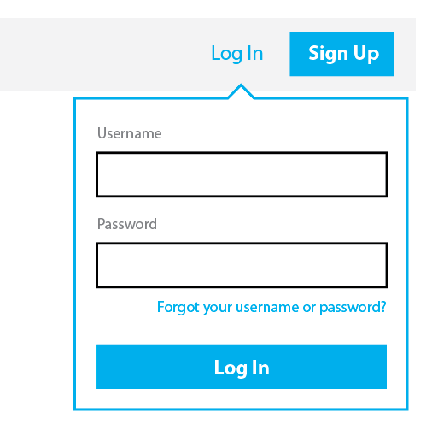

Slide 3

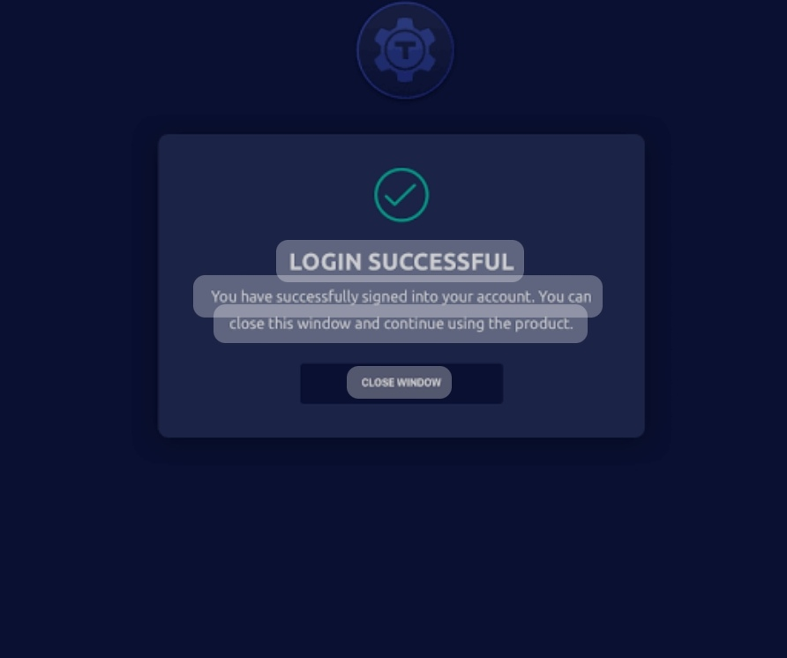
LOGOUT

Slide 4
LOGOUT
HOME PAGE
1. Manage supplier Information
2. View and process purchase requests
3. Create request for quotation
4. Process quotation from supplier
5. Create purchase orders
6. Delivery notes

Slide 5
LOGOUT
SUPPLIER INFORMATION
PLEASE FILL IN BELOW
Supplier ID
Supplier Name
Address
Contact No
Email
Delivery Dates
000-000-0000
Username@gmail.com
DD/MM/YYYY

Slide 6
LOGOUT
INFORMATION SUBMITTED
ORDER STATUS:
PENDING…
YOU WILL GET THE STATUS ONCE YOUR ORDER IS CONFIRMED
RESTART PROCESS
DONE

Slide 7
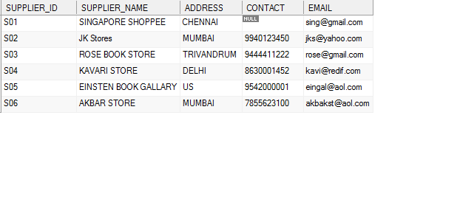
LOGOUT
Supplier List

Slide 8
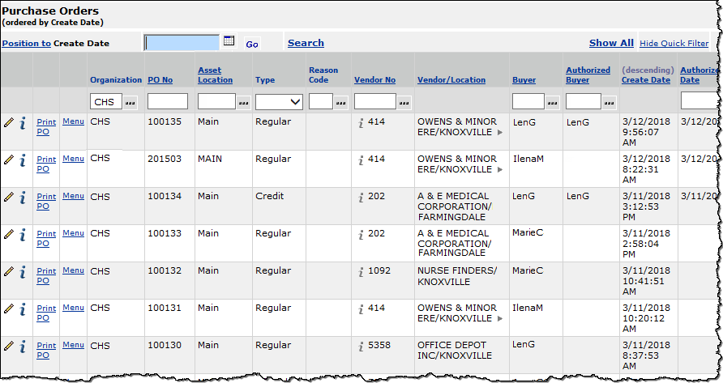
LOGOUT
PURCHASE ORDERS
OPEN
DELETE

Slide 9
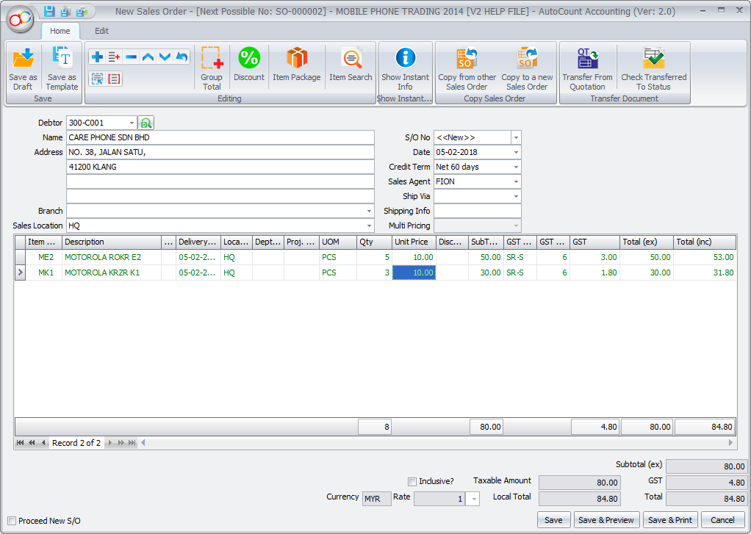
View and process purchase requests
LOGOUT
APPROVE
REJECT
This Photo by Unknown Author is licensed under CC BY-SA

Slide 10
LOGOUT
REQUEST FOR QUOTATION
Fridge brand | Quantity | Price | Status
LG | 10 | R20 000 | Approved
SAMSUNG | 10 | R19 500 | Approved
MAYTAG | 10 | R21 300 | Approved
BOSCH | 10 | R15 000 | Approved
HISENSE | 10 | R12 342 | Approved
SEND REQUEST

Slide 11

LOGOUT
RFQs TO SUPPLIERS
REQUEST SUBMITTED
Respond by:
DD/MM/YYY

Slide 12
LOGOUT
EVALUATE QUOTATION
SUPPLIER ID
PRICE
DELIVERY
SUBMIT

Slide 13
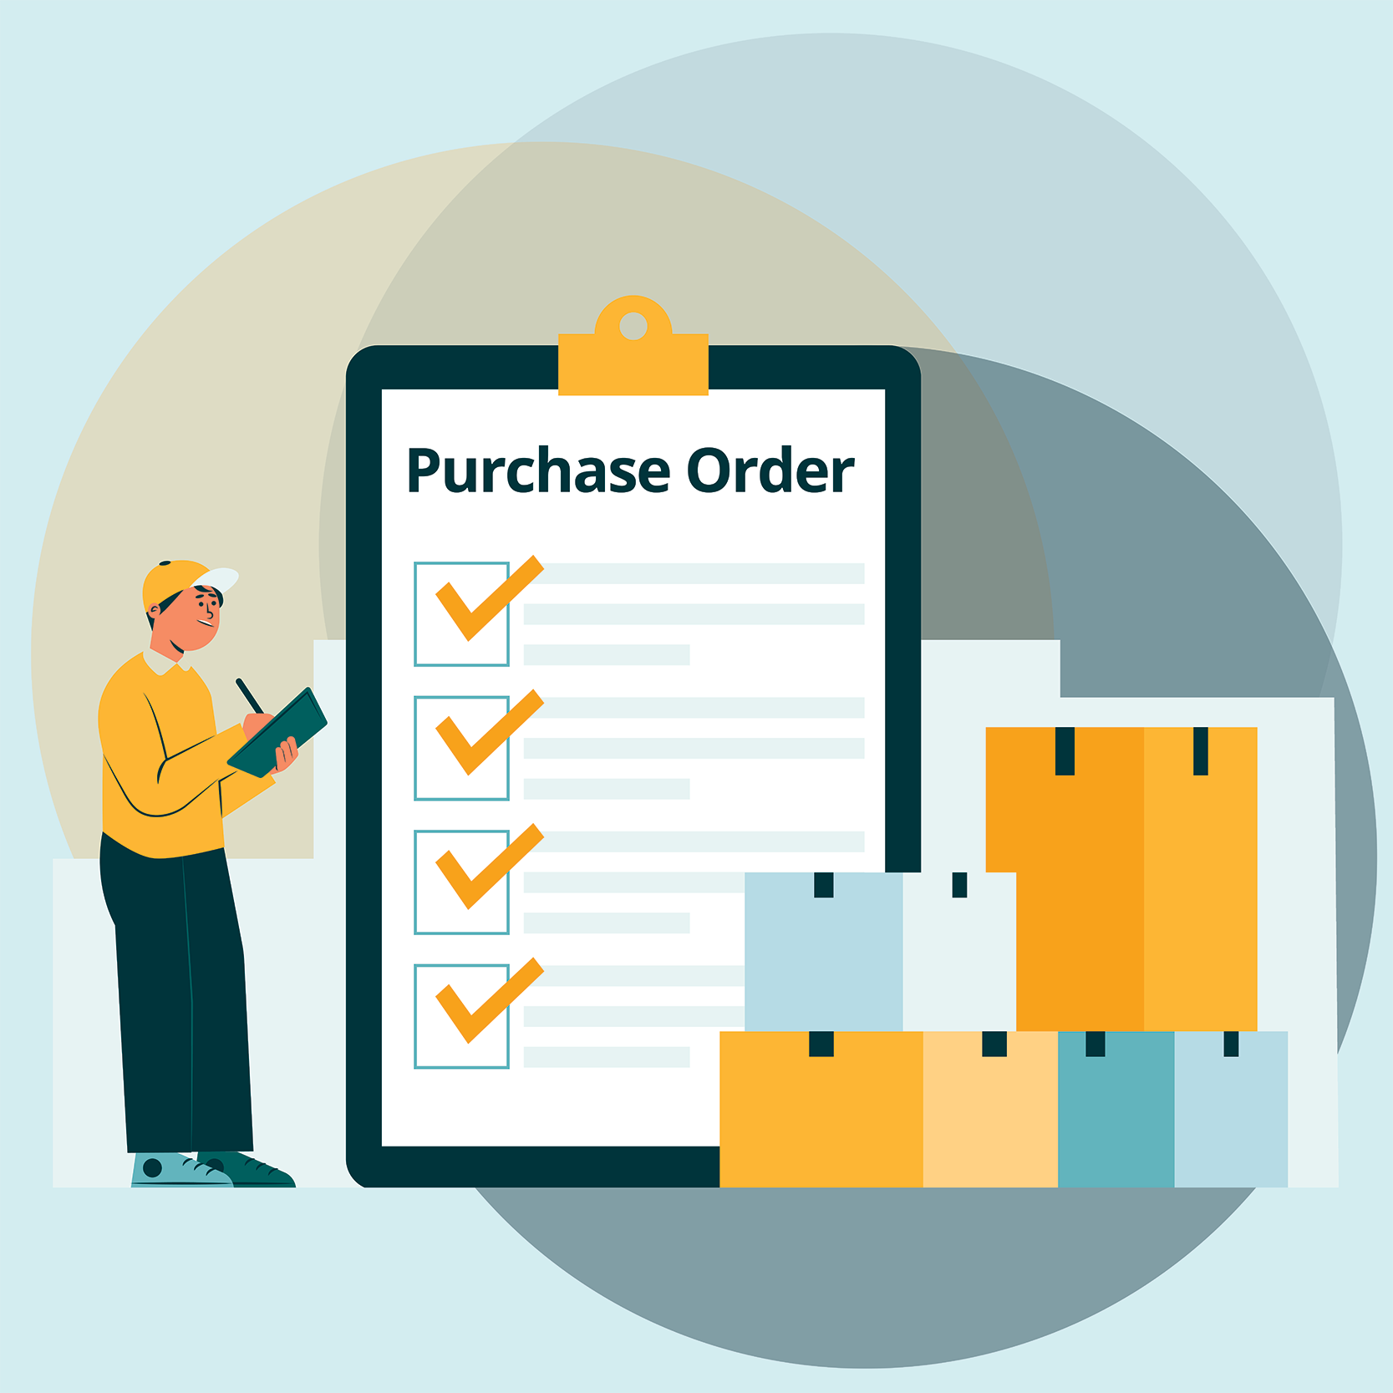
LOGOUT
DISPLAY CHOSEN PURCHASE ORDER
ITEMS
QUANTITY
PRICE
DELIVERY

Slide 14
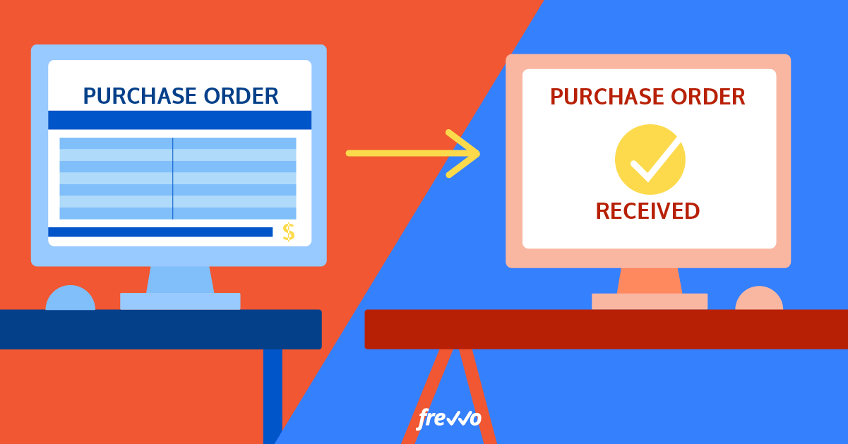
LOGOUT
FINALIZED PO TO CHOSEN SUPPLIER

Slide 15
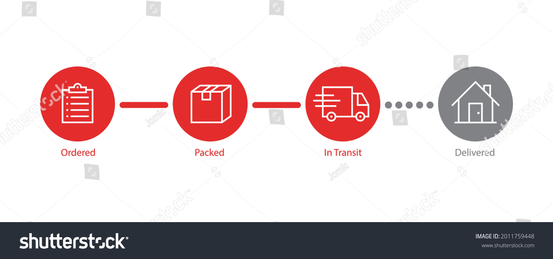
LOGOUT
ORDER DATE
DD/MM/YYYY
ESTIMATED DELIVERY
DD/MM/YYYY

Slide 16


LOGOUT
INSPECTION
GOODS RECIEVED
DAMAGED GOODS

Slide 17

UPDATE SYSTEM RECORDS
LOGOUT
DELIVERED ITEMS
RECIEPT
SUPPLIER
ADDRESS
FINANCIAL SYSTEM
SUPPLIER INVOICE
PHYSICAL STOCK

Slide 18
LOGOUT
UPDATE SUCCESSFUL
THANK YOU FOR THE UPDATE
RESTART THE PROCESS
DONE

Slide 19
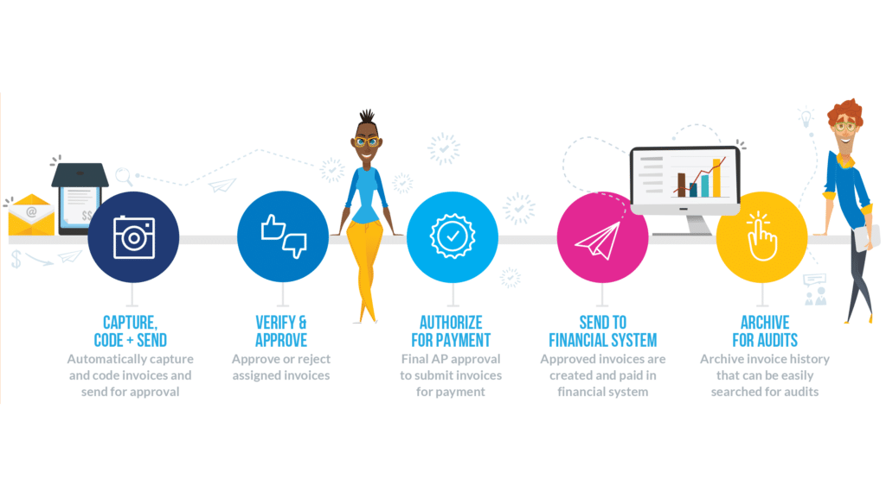
LOGOUT
PROCESSN SUPPLIER INVOICE FOR PAYMENT

Slide 20
LOGOUT
PURCHASE REQUEST
COMPLETE

Slide 21
LOGOUT
Need help to navigate the system?
Call: 0800 555 3000
Email:Executive@chilleth.co.za

Slide 22

Write Review
Type here:
RATE US:
SUBMIT

Slide 23
THE END

